Slide 1
Calorimetric Efficiency Measurement

Slide 2
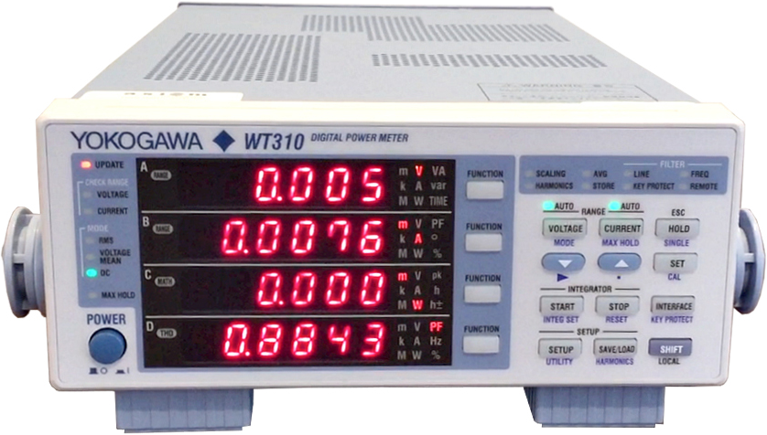
Typical power analyzers have 1% deviation for current and voltage measurement
which means
For a 10A, 300V system
Power deviates between 2940W to 3060W
Efficiency varies between 102% to %98
Measurement is not accurate!

Slide 3
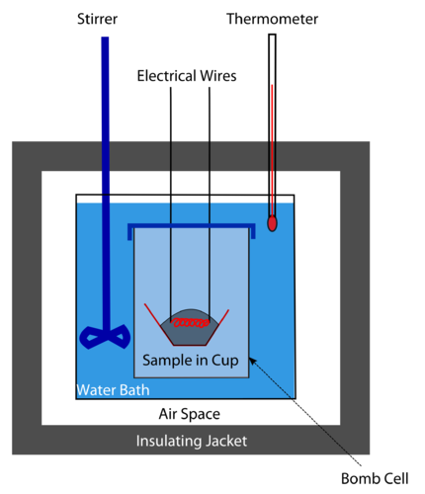
Calorimetric Efficiency Measurement
Aims to measure power loss, so percent deviation is far lower
Works based on comparison of two loss sources or heat capacity of a flowing element (water)
Highly preferred for high efficiency power converter applications

Slide 4
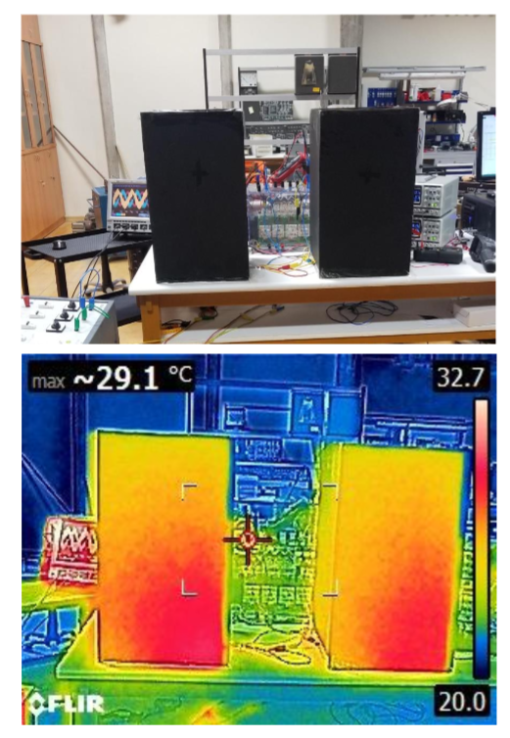
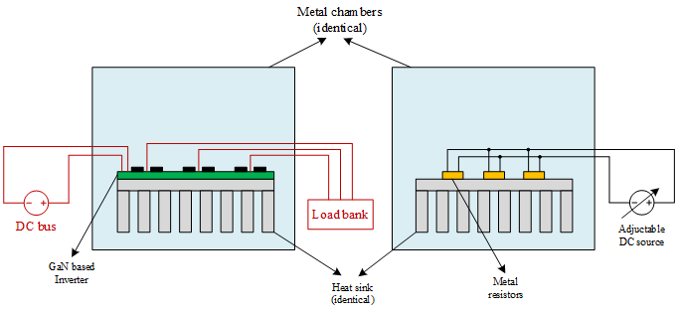
Loss Comparison
Two black boxes are compared thermally
There is a DUT(Device-under-test) inside one of the box box and a resistor in other box
Certain loss is applied on resistors and after the boxes reaching thermal steady state, their temperatures are compared. If one of them is hotter than other one, there is more loss production inside that box.
The loss on the resistor is changed over time to obtain the same temperature with DUT box.

Slide 5
Loss Comparison - Challenges
Temperature measurement accuracy
Human error
Measurement tool error
Long times before reaching the steady-state
Increased ambient temperature
Local heating in a box
Several measurement sensors placed for multiple measurement points
Small boxes or estimating final temperature from the heating curve
Large boxes or cooling inside of the boxes down
Heat should be distributed homogeeously inside the box

Slide 6
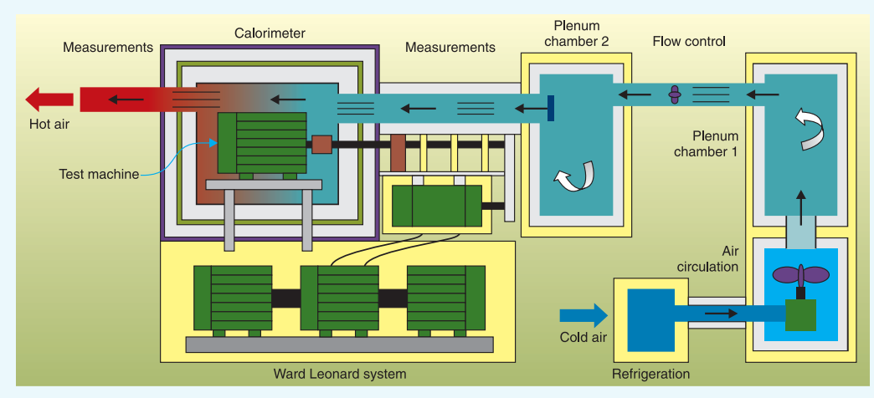
Using Heat Capacity of a Flowing Element

Slide 7
Using Heat Capacity of a Flowing Element - Challenges
Homogene distribution of the flow element
Multiple connectivity especially for water coolant
Isolating the box from outside
Airflow or water flow damper
Requires creative ideas
Thick borders

Slide 8
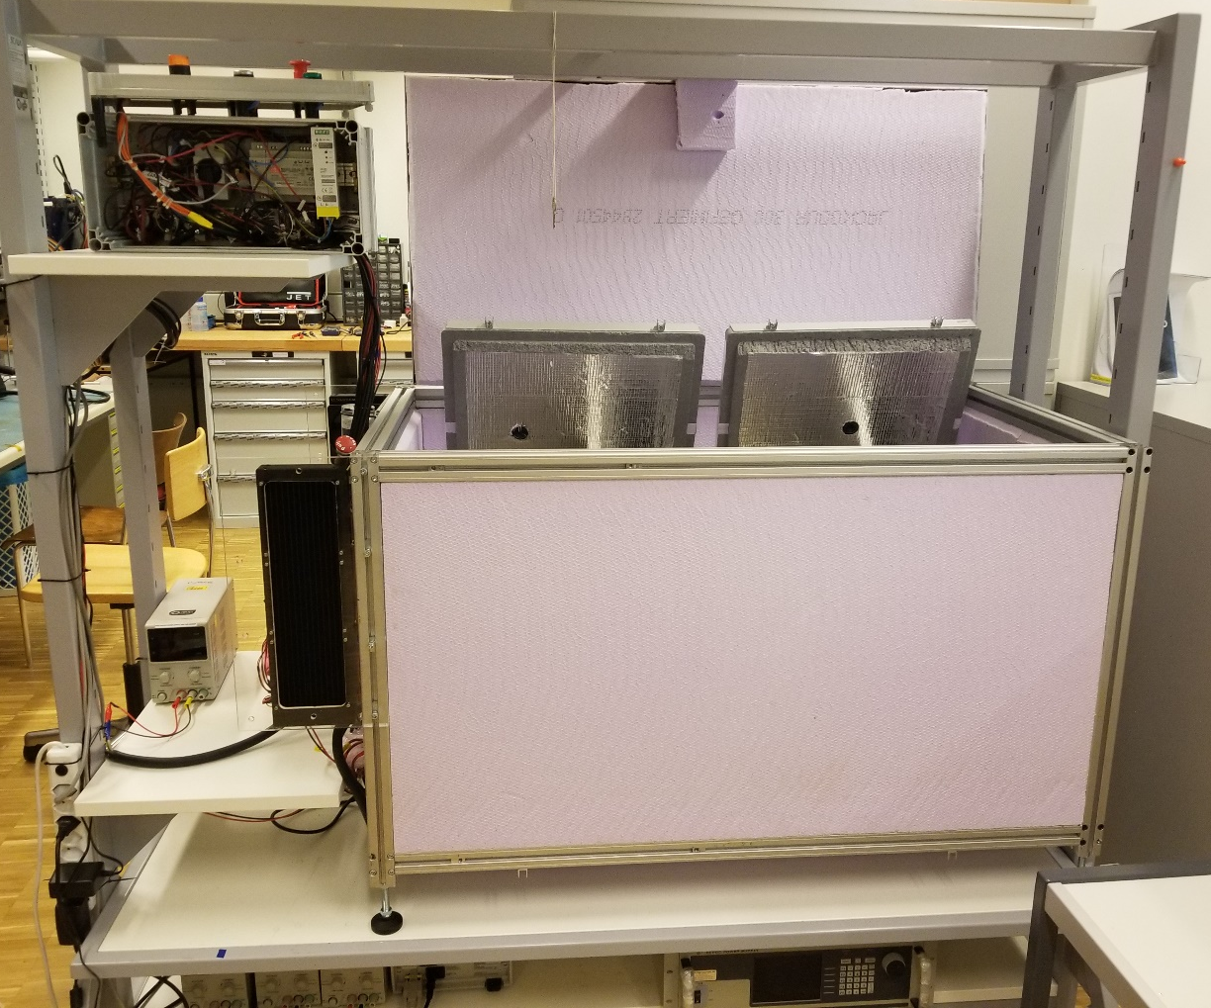
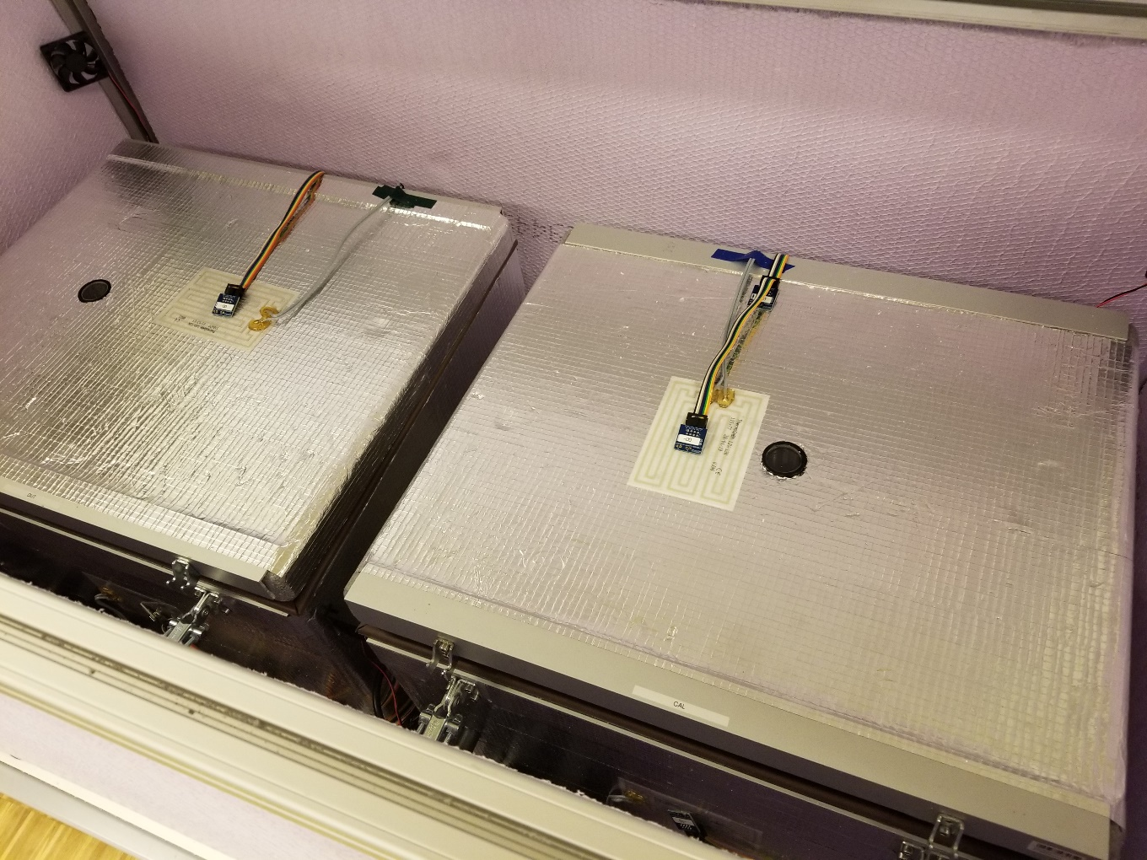
A solution from PowerLab, EPFL

Slide 9
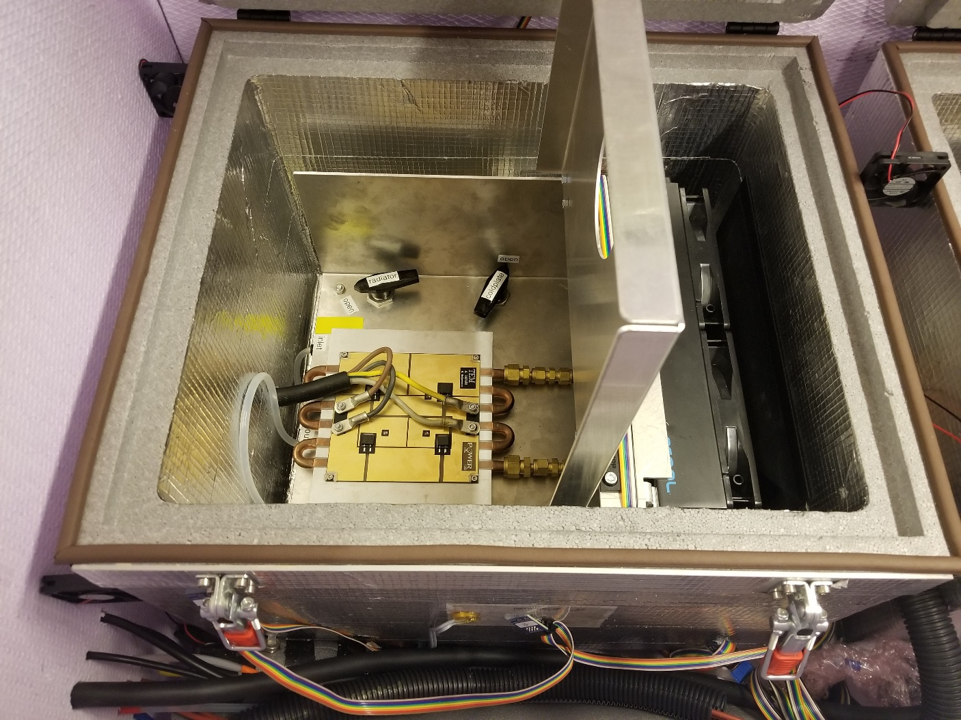
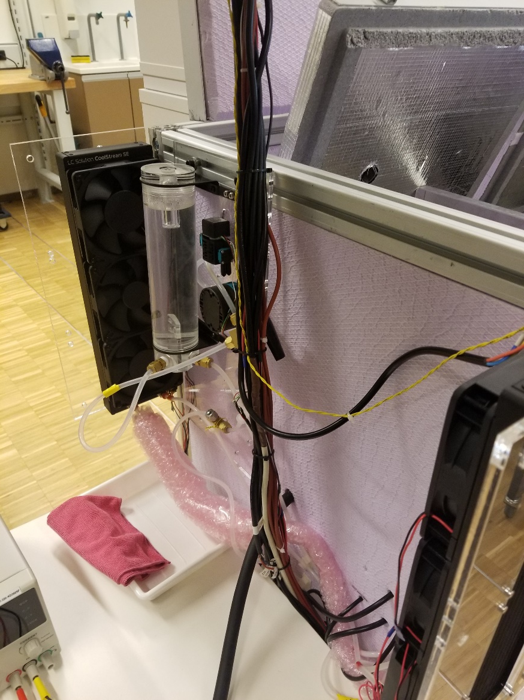
A solution from PowerLab, EPFL

Slide 10
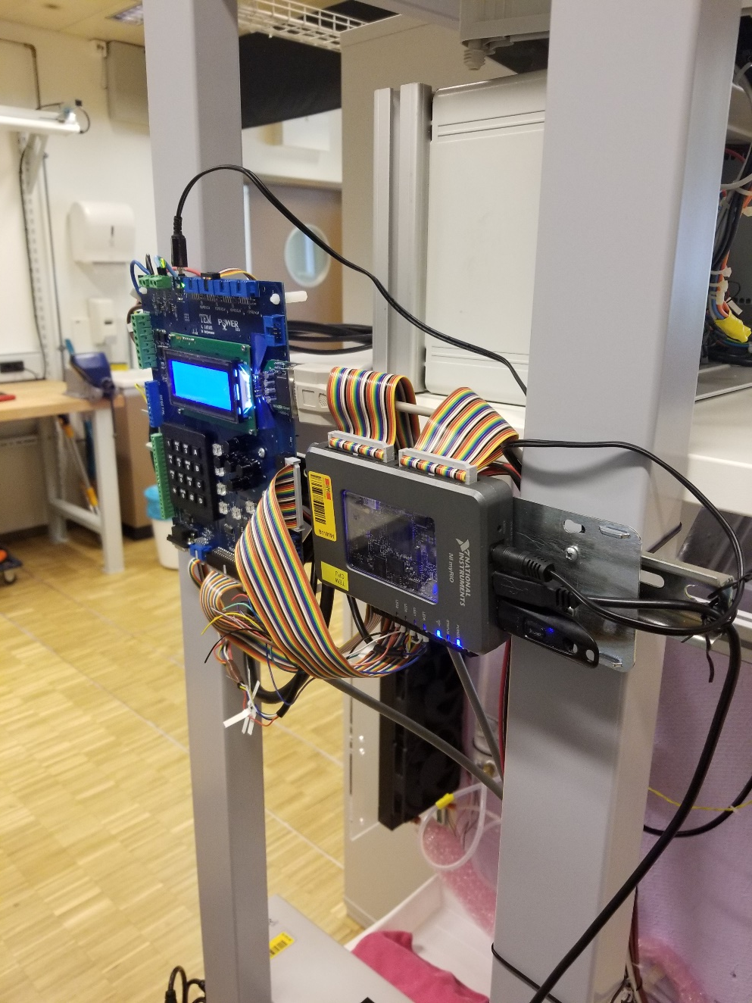
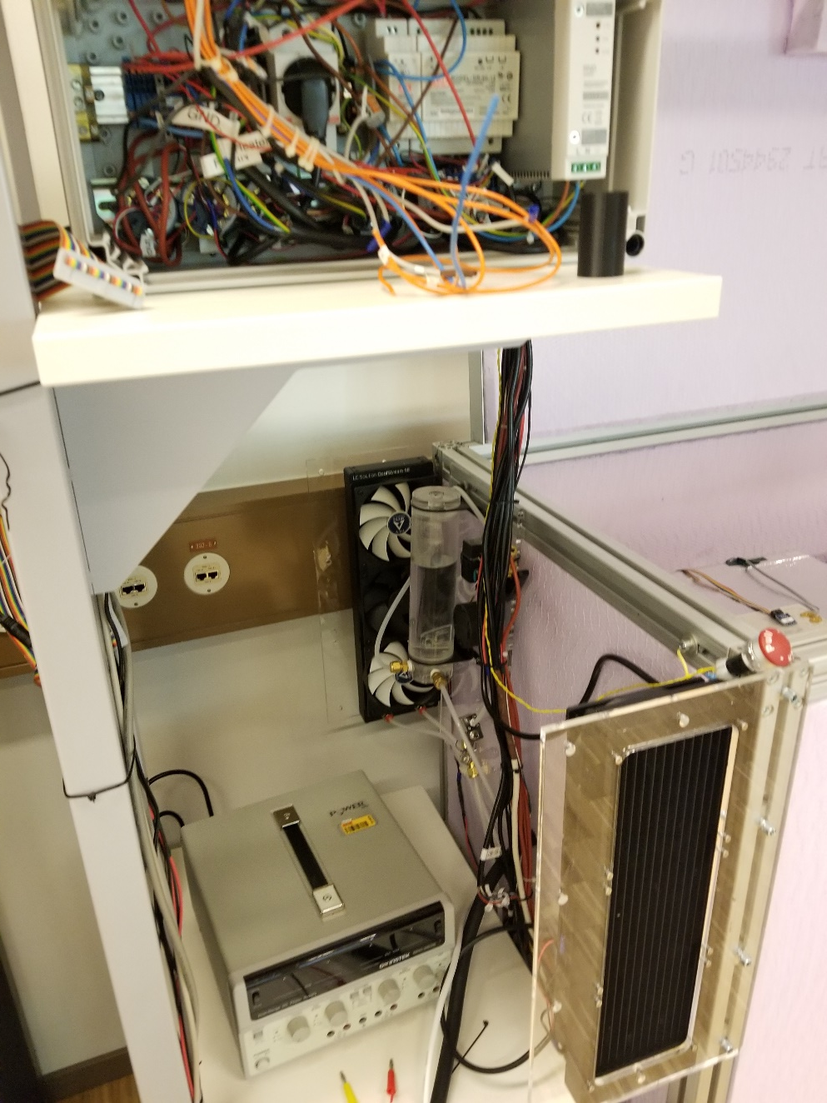
A solution from PowerLab, EPFL

Slide 11
References
High-Power Solar Inverter Efficiency Measurements by Calorimetric and Electric Methods, Lassi Aarniovuori, Antti Kosonen, Pekka Sillanpaaa, and Markku Niemela
Development of a High-Precision Calorimeter for Measuring Power Loss in Electrical Machines, Wenping Cao
A REVIEW OF CALORIMETRIC APPLICATION FOR ACCURATE POWER LOSS MEASUREMENT, W. Cao

